Slide 1

Week 12 Update: PSL Project
Shray Gupta
4/7 - 4/13

Slide 2
Completed Tasks
Completed Milestone 4c — secure password storage (salted hash, verification, EEPROM layout) and integration with the full locker behavior.
Reengineered Milestone 4a — 5 V rail monitoring, buzzer behavior, and how power alerts interact with the rest of the firmware before folding it into the main sketch.
Fixed memory pressure and brownout-related failures — reduced RAM/stack load and stabilized operation so crypto, EEPROM, LEDs, buzzer, and servo could run together without resetting.

Slide 3
Task 1: Detailed Update
Objective
Detect a weak 5 V rail before brownout and alert the user using visible (LEDs) and audible (buzzer) feedback, integrated with the rest of the locker firmware.
Method / Approach
Password never stored in plaintext — only a 16-byte random salt and 32-byte SHA-256(salt ‖ password bytes) are written to EEPROM.
SHA-256 implemented in firmware (no crypto library) — single code path used for save and verify; optional known test vector over Serial to prove correctness before relying on the lock.
EEPROM record layout — magic + version + password length metadata + salt + hash; commit order written so a reset mid-write does not leave a valid-looking record (invalidate first, write payload, commit magic last).
Verification — reload stored salt/hash, recompute hash from entered digits, compare with a fixed-length, constant-time byte compare (no early exit).
Legacy handling — if old plaintext EEPROM format (AB …) is detected, migrate once on boot to the new salted-hash format.
Integration — same verify function for keypad unlock and Serial T; saving a new code hashes and rewrites the secure record.
Buffers — sensitive stack buffers zeroed after hashing where applicable.

Slide 4
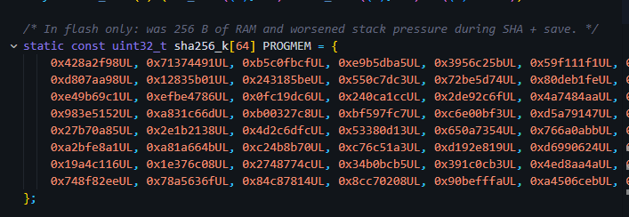
Task 1: (continue)
sha256_k[64] in PROGMEM (saves RAM).

Slide 5
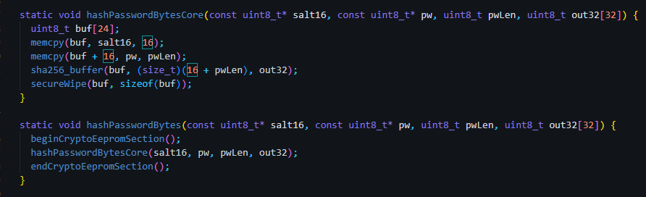
Task 1: (continue)
Hashing the password

Slide 6
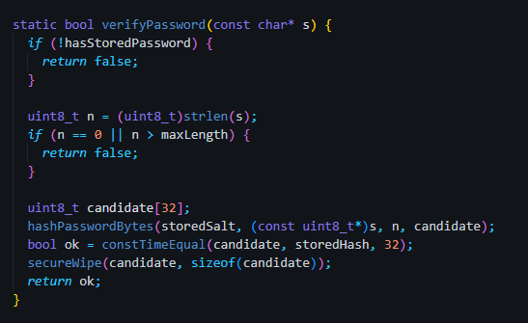
Task 1: (continue)
New verify password

Slide 7
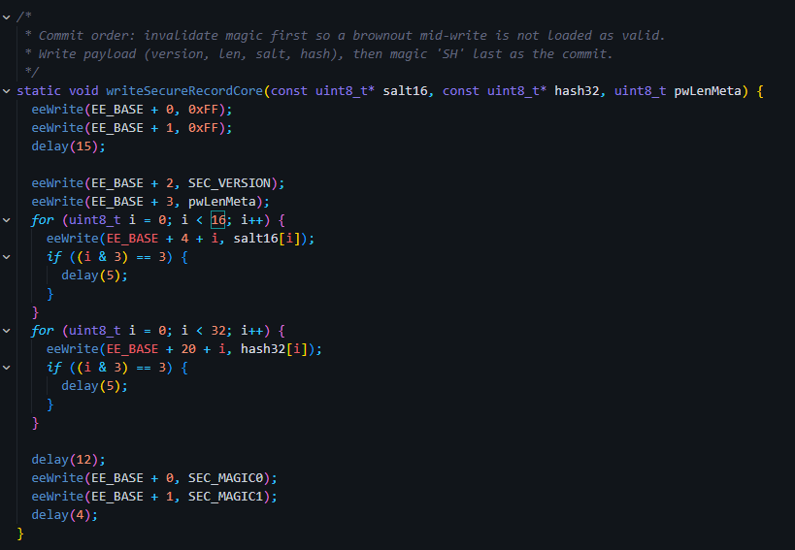
Task 1: (continue)
EEPROM write order

Slide 8
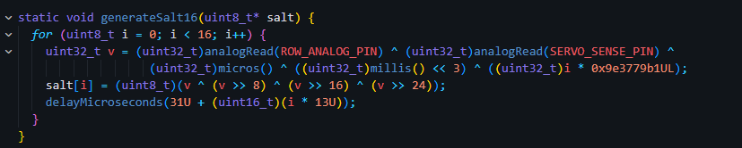
Task 1: (continue)
salting

Slide 9
Task 1: (continue)
Key results
All the existing functions work properly but integrate with the new salting and encryption algorithms.
Secure storage: Password is never stored in plaintext; EEPROM holds 16-byte salt + 32-byte SHA-256(salt ‖ password) with a defined magic / version record layout.
Verification: Unlock path recomputes the hash and compares with constTimeEqual (fixed 32-byte compare).
Legacy upgrade: Old AB plaintext records are detected and migrated once to the new format on boot.
Integration: Same verify path for keypad unlock and Serial T; S saves a new salted hash.
Sanity check: Serial T shows UNLOCK / DENIED correctly for good vs bad codes after a save.

Slide 10
Task 2: Detailed Update
Objective
Extend the existing 4a implementation, low-supply / rail-alert behavior so alerts are shown on LEDs as well as the buzzer, with shared timing per alert level.
Method / Approach
I kept the same rail checks and levels I was using before.
I wired the LEDs into that: when we’re in a warning, I drive yellow; when we’re critical, I drive red — in sync with the buzzer (same on/off timing for that level).
I also pause the rail LED + buzzer for a moment when other stuff is happening (wrong password, wake, save-password flow) so those screens aren’t fighting the battery alert.

Slide 11
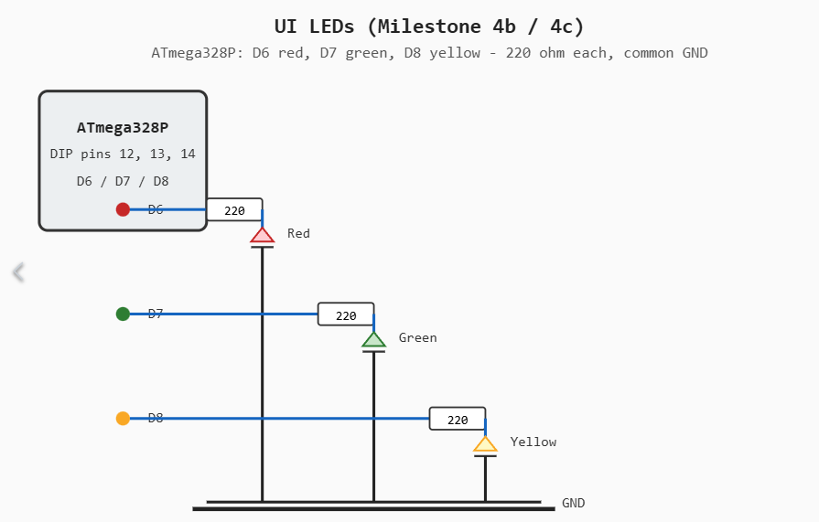
Task 2: (continue)
Any schematic, simulation, measurement, derivation, and equations

Slide 12
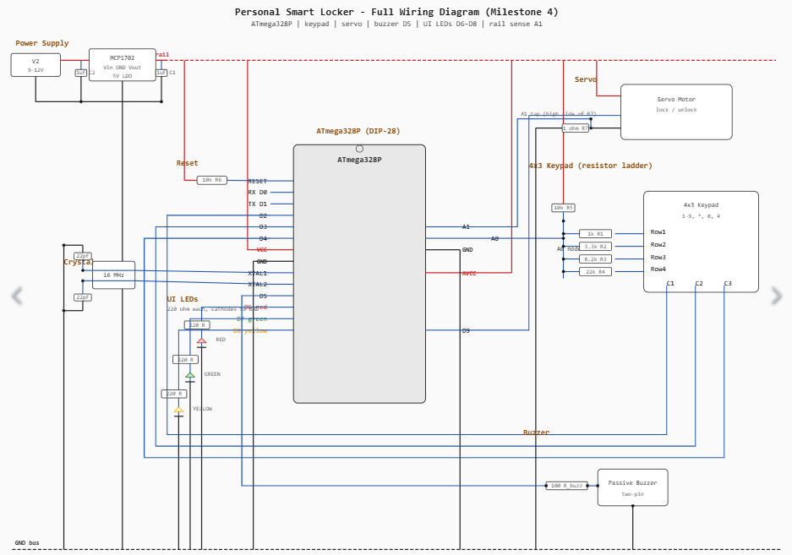
Task 2: (continue)

Slide 13
Task 3: Detailed Update
Objective
Stop resets/brownouts under full load so crypto + EEPROM + LEDs + buzzer + servo can run together reliably.
Method / Approach
Reduce RAM/stack pressure (move big tables to flash/PROGMEM, reuse static buffers, avoid large temp arrays).
Brownout-safe EEPROM writes (stagger writes + small delays; commit/“magic last” so partial writes aren’t treated valid).
Load-shedding during crypto/EEPROM (temporarily stop buzzer + LEDs while hashing/writing to reduce rail dips).
Rail-aware sequencing (pause UI/buzzer patterns around sensitive operations; avoid simultaneous peak current events).
Verify by stress test: repeat save/verify + LED/buzzer + servo motion without watchdog/brownout resets.

Slide 14
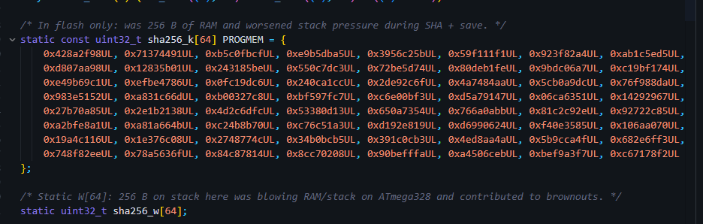
Task 3: (continue)
Reduced RAM/stack pressure: SHA-256 constants moved to flash (PROGMEM) and W[64] uses a static buffer instead of stack.

Slide 15
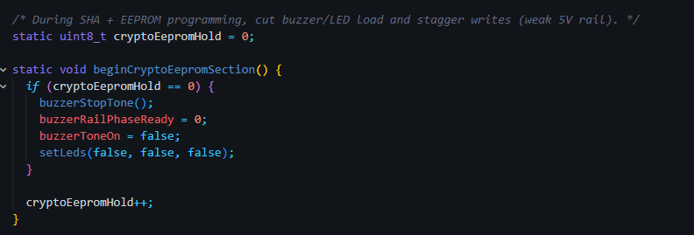
Task 3: (continue)
Mitigated brownouts: disable buzzer + LEDs during hashing/EEPROM operations to reduce peak current and rail dips.

Slide 16
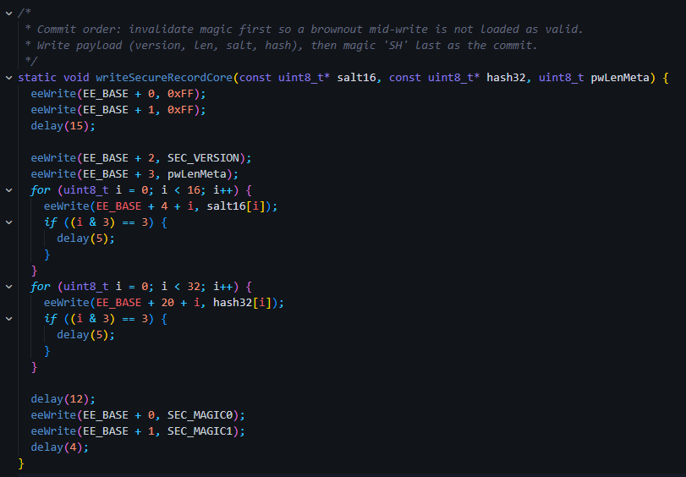
Task 3: (continue)
Brownout-safe EEPROM writes: invalidate magic first, stagger writes with delays, then commit ‘magic’ last so partial writes aren’t treated as valid.

Slide 17
Exceptional points
Method / Approach
Two-tier alerts with meaningful UX: separate warning (yellow) vs critical (red) patterns, and LEDs + buzzer blink in sync (same ON/OFF timing).
Salted hashing, no plaintext: store only 16‑byte salt + SHA‑256(salt‖password) in EEPROM (password never stored/read back).
Constant‑time verify: compare hashes with a constant‑time function to avoid timing leaks.
Brownout‑resilient EEPROM format: magic‑last commit so a mid‑write reset can’t create a “valid but corrupted” password record.
Migration support: auto‑detect and upgrade legacy plaintext EEPROM records on boot (backwards compatible).
Hardware-aware crypto: reduced failure rate by load‑shedding during hash/EEPROM (turn off buzzer/LEDs) and reducing RAM/stack pressure so security works reliably with the rest of the system.

Slide 18
Plan for Next Week
List the tasks that are planned for the following week
Finish milestone 4e
Figure out the servo issue and get it working on the 5v rail.
Expected deliverables
Demonstrate that the entire system works with all required features and the additional optional features that your team selected. (10%)
Servo on the 5v rail

